Slide 1
Nhóm 9: AN ADAPTIVE FUSION METHOD BASED ON REGIONAL FEATURE FOR ALOS IMAGE. AUTHORS: XIAO-YAN WANG, YONG LIU, ZHI-YONG JIANG
Đinh Khắc Quý – 15022862
Nguyễn Văn Tùng - 15021366

Slide 2
Overview
1. Motivation of fusion methods for satellites images.
2. Four common image fusion methods.
3. The proposed method.
4. Experiment and result of the proposed method.
5. Conclusion.

Slide 3
I. Motivation of fusion methods for satellites images
More and more high resolution satellites, such as SPOT5, IKONOS, QuickBird, ALOS have been launched.
Panchromatic image and multispectral image.
Recent researches focus on using high-resolution images on various fields.
A good fusion method combines panchromatic image with multispectral image.

Slide 4
I. Motivation of fusion methods for satellites images
Have been developed past two decades.
Cliche et al. presented a fusion method integrate SPOT panchromatic image into multispectral image.
Li et al. used the discrete wavelet frame transform.
Chen et al. used surface texture information.
Zhang et al. used advantages of both the IHS and the wavelet techniques.

Slide 5
I. Motivation of fusion methods for satellites images
ALOS is a new land observing satellite of Japan was lunched in Jan,2006.
Propose a fusion method for ALOS images.

Slide 6
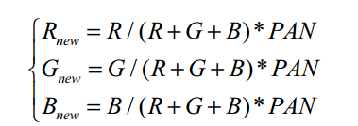
II. Four common image fusion methods 1. Brovey transform fusion scheme
To increase visually contrast of images such as contrast in shadows, water, or high reflectance areas.
Use a ratio algorithm to combine the images:

Slide 7
II. Four common image fusion methods 2. Standard IHS fusion scheme – The idea
RGB is usually used by computer monitors to display color images.
HIS is more consistent to human visual system.
H(hue), I(intensity), S(saturation).
When convert an image from RGB space to HIS space leads to the idea of HIS fusion scheme.

Slide 8
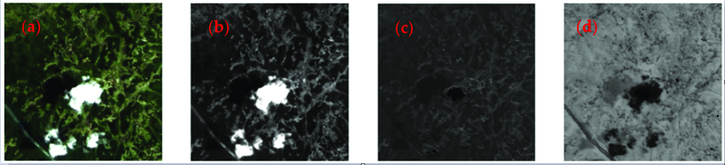
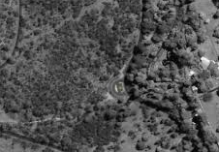
An example of RGB to IHS
Panchromatic image

Slide 9
II. Four common image fusion methods 2. Standard IHS fusion scheme – the practise
The old problem: color distortion.
The HIS fusion scheme to reduce color distortion:
Stretch panchromatic image to mean and standard deviation of the intensity component image of the multispectral image.
Replace intensity image with stretched panchromatic image.

Slide 10
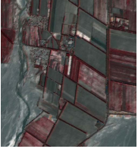
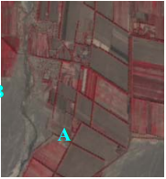
II. Four common image fusion methods 2. Standard IHS fusion scheme – the result
High correlation between panchromatic image and intensity component image.
Often have high color distortion.
Shows plentiful color in the fusion results and was used popularly.
IHS fusion image
The Origin multispectral
image

Slide 11
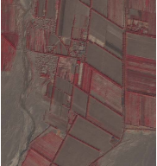
II. Four common image fusion methods 3. HPF (High pass filter) fusion scheme
The detail information of panchromatic is extracted and added to each band (RGB) of multispectral image.
HPF fusion image
The Origin multispectral
image

Slide 12
II. Four common image fusion methods 4. DWT (discrete wavelet transform) fusion scheme
An underlying down-sampling process, it is multiresolution decompositions.
Cause a shift variant.
DWT fusion image
The Origin multispectral
image

Slide 13
III. THE PROPOSED METHOD A fusion method based on regional feature for ALOS image
Based on IHS fusion scheme idea:
Modify the high-resolution panchromatic image.
To look more like the intensity component of the multispectral image.
The proposed method makes an adaptive partial replacement based on SSIM.

Slide 14
III. THE PROPOSED METHOD A fusion method based on regional feature for ALOS image
1. Register a pair of panchromatic and multispectral images.
2. Resample multispectral image to the size of panchromatic image.
3. Transform the resample multispectral image from RGB to IHS color space to obtain the intensity component image.
4. Appling histogram matching between the intensity component image and the panchromatic image to get a new panchromatic image called Pnew.

Slide 15
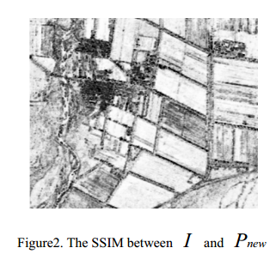

III. THE PROPOSED METHOD A fusion method based on regional feature for ALOS image
5. Calculating the SSIM index between the Pnew and I within a local square window and taking the central pixel value of the window, then moving pixel-by-pixel over the entire image, we can obtain a SSIM metric. If the SSIM index is higher than thresholdT , I will be replaced by Pnew. Otherwise, I will be preserved. So we have an image Inew.

Slide 16
III. THE PROPOSED METHOD A fusion method based on regional feature for ALOS image
Use the window with size 7*7.
Threshold T as the mean SSIM index.
6. Perform an IHS to RGB transform on Inew.

Slide 17
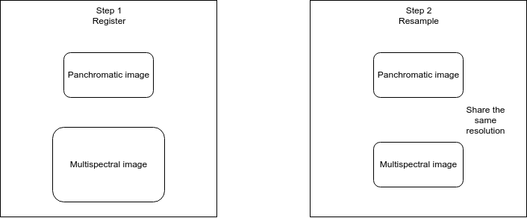
II. THE PROPOSED METHOD A fusion method based on regional feature for ALOS image

Slide 18
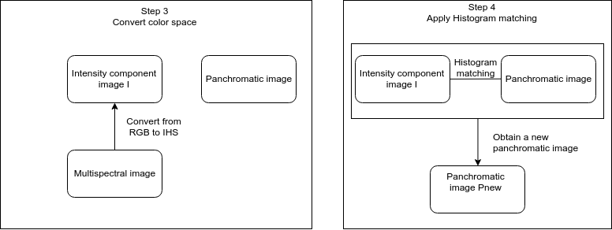
II. THE PROPOSED METHOD A fusion method based on regional feature for ALOS image

Slide 19
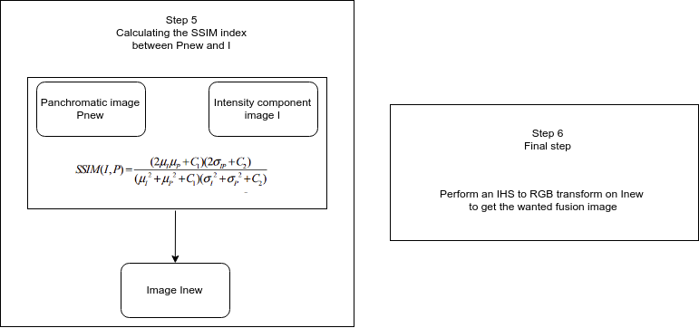
II. THE PROPOSED METHOD A fusion method based on regional feature for ALOS image

Slide 20
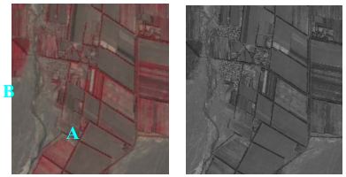
IV. Experiment and result of the proposed method
Qinghai province, China.
Subset image size is 1024*1024
Crops, bare soil, roads, and populated subdivision with houses.
Multispectral
image
Panchromatic
image

Slide 21
IV. Experiment and result of the proposed method – Some principles
Fusion results from different techniques should be evaluated visually, spectrally and spatially.
All the fused images inherited high spatial information from the panchromatic image.
The color distortion is different.

Slide 22
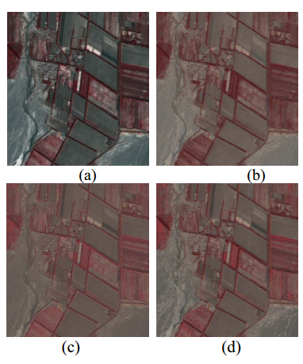
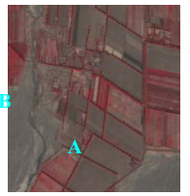
IV. Experiment and result of the proposed method – Using visual evaluation
Origin Multispectral
image
(a) IHS transform method.
(b) Brovey transform method.
(c) HPF method.
(d) The proposed method.

Slide 23


IV. Experiment and result of the proposed method – Using formula evaluation
Discrepancy
The band discrepancy is computed:
Pearson’s correlation coefficient

Slide 24
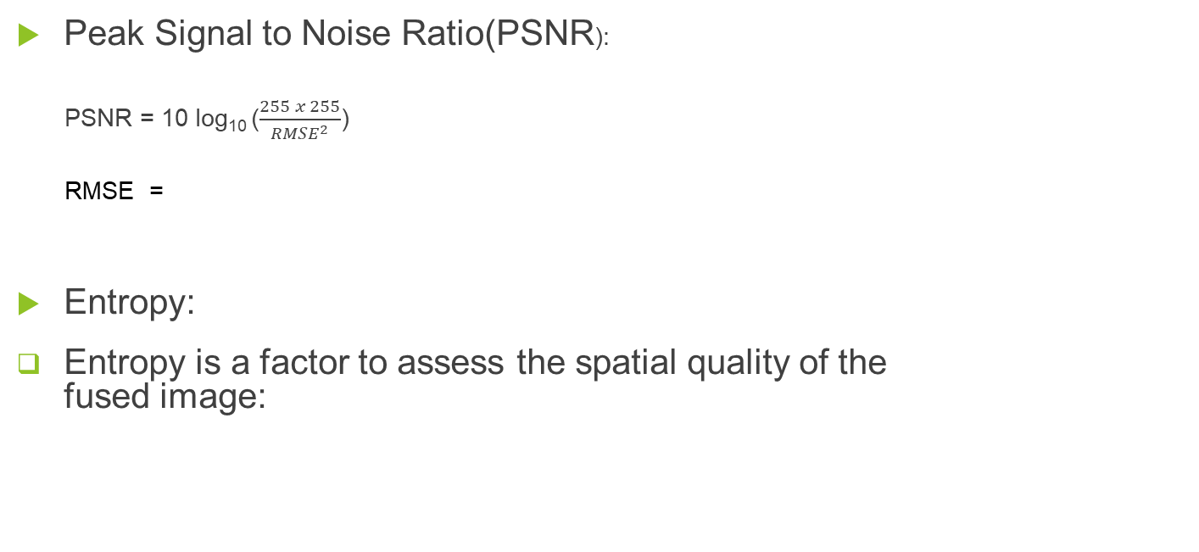


IV. Experiment and result of the proposed method – Using formula evaluation
for i = 1:N
for j = 1:M
Count(Image(i,j)+1)=Count(Image(i,j)+1)+1;
End
Prob = Count/(M*N)

Slide 25
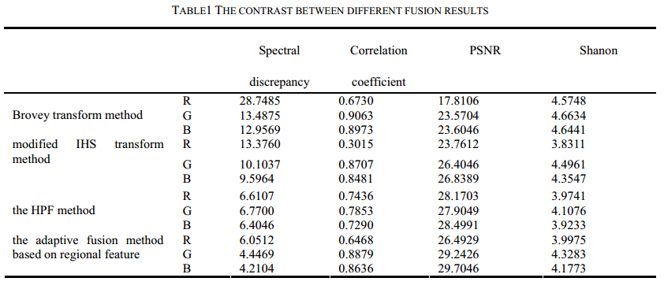
IV. Experiment and result of the proposed method – Using formula evaluation

Slide 26
V. Conclusion
The adaptive fusion method based on regional feature presented in this paper is suitable to ALOS image.
Images inherit high spatial information from the panchromatic image.
Color distortion.
Atomating the best design of filters (threshold) and the window size according to the image to be fused.
Other approaches for quality assessment of the fused image should be investigated in future.
Google slides: https://docs.google.com/presentation/d/1MesIKRq_83u2dR6bGFnZiiLWn92fmv4YanCC0cMD4EY/edit?usp=sharing

